Slide 1
Web Driver Commands
2025
Poornima

Slide 2
Browser Navigation Commands
get(url) - Opens a webpage
driver.get("https://www.amazon.in");
navigate().to(url) - driver.navigate().to("https://google.com");
navigate().back() - Go to the previous page.
navigate().forward() - Go forward in history
navigate().refresh() - Reload the current page.

Slide 3
Element Locator Commands
findElement(By locator) - Finds a single element
driver.findElement(By.id("username"));
findElements(By locator) - Finds multiple elements (returns a list)
driver.findElements(By.tagName("a"));

Slide 4
WebElement Interaction Commands
Once you locate an element, you can interact with it.
click() : driver.findElement(By.id("login")).click();
sendKeys("text"): driver.findElement(By.name("email")).sendKeys("test@gmail.com");
clear(): driver.findElement(By.id("search")).clear();
getText(): String title = driver.findElement(By.tagName("h1")).getText();
getAttribute("value"): String value = element.getAttribute("value");
Conditional Methods:
isDisplayed() - we can check display status of the element
isEnabled() – To check enable/disable status of the element/operational element
isSelected() - To check the element is selected or not( for radiobutton, checkbox, dropdown)

Slide 5
Browser Information Commands
getTitle() - returns title of the page
driver.getTitle();
getCurrentUrl() - returns URL of the page
driver.getCurrentUrl();
getPageSource() - returns HTML page source of the current focused Browser
driver.getPageSource();

Slide 6
Window & Tab Commands
getWindowHandle()
Returns the current window ID.
getWindowHandles()
Returns all open window IDs.
switchTo().window(id)
Switch between tabs/windows.

Slide 7
Cookie Commands
manage().getCookies()
Retrieve cookies.
manage().addCookie()
Add a cookie.
manage().deleteAllCookies()
Clear cookies.

Slide 8
Window Management Commands
manage().window().maximize()
manage().window().minimize()
manage().window().fullscreen()

Slide 9
Wait Commands
In Selenium, wait commands are used to synchronize the execution of test scripts with the state of the web application.
Wait Commands help ensure that the script waits for certain conditions to be met before proceeding, which is crucial for dynamic web pages where elements may take time to load.
Types of wait:
Implicit Wait
Explicit Wait
Fluent Wait

Slide 10
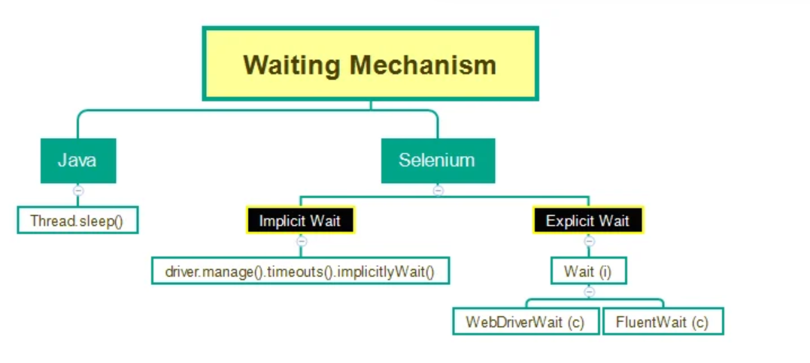
Wait Commands

Slide 11
Implicit Wait
Sets a global timeout for the WebDriver to find elements.
If an element is not found immediately, the driver waits for the specified duration before throwing a NoSuchElementException.
Applies to all findElement and findElements calls throughout the test script.
driver.manage().timeouts().implicitlyWait(Duration.ofSeconds(10));

Slide 12
Explicit Wait
Used to pause execution until a specific condition is met for a particular element.
More precise than implicit waits as it targets individual elements and conditions.
Implemented using WebDriverWait and ExpectedConditions.
WebDriverWait wait = new WebDriverWait(driver, Duration.ofSeconds(10));
WebElement element = wait.until(ExpectedConditions.visibilityOfElementLocated(By.id("elementId")));

Slide 13
Explicit Wait - conditions
alertIsPresent()
elementSelectionStateToBe()
elementToBeClickable()
elementToBeSelected()
frameToBeAvaliableAndSwitchToIt()
presenceOfAllElementsLocatedBy()
presenceOfElementLocated()
textToBePresentInElement()
textToBePresentInElementLocated()
textToBePresentInElementValue()
titleIs()
titleContains()
visibilityOf()
visibilityOfAllElements()
visibilityOfAllElementsLocatedBy()
visibilityOfElementLocated()

Slide 14
Fluent Wait
An advanced form of explicit wait, offering greater control over waiting behavior.
Allows defining the maximum wait time, polling interval, and exceptions to ignore during the wait.
Useful for highly dynamic elements or conditions that require frequent checks.
Each FluentWait instance defines the maximum amount of time to wait for a condition, as well as the frequency with which to check the condition.
Furthermore, the user may configure the wait to ignore specific types of exceptions whilst waiting, such as NoSuchElementExceptions when searching for an element on the page.

Slide 15
Fluent Wait
Wait<WebDriver> wait = new FluentWait<WebDriver>(driver)
.withTimeout(Duration.ofSeconds(time))
.pollingEvery(Duration.ofSeconds(time))
.ignoring(NoSuchElementException.class);
WebElement foo = wait.until(new Function<WebDriver, WebElement>() {
public WebElement apply(WebDriver driver) {
return driver.findElement(By.id("foo"));
}

